Slide 1
Multilevel Object Closure Detection By Superpixels
CSC 2523
April 11th, 2018

Slide 2
Motivations
An image usually has multiple objects within, and they may be at different levels.
Giving a single name tag to describe an image with multiple objects within can be not efficient.
An image can not only tell objects, but also show relationships among them.
Therefore, extracting objects at different levels and estimating their relationships will be important for processing images and data augmentation for other usages.

Slide 3
Objectives
Extract major objects on the same level.
Within a reasonable large object, extract all possible next level objects.
Build a tree structure to describe the relationships (either brotherhood or descendent) among objects.

Slide 4
Introduction
The mechanism to detect a possible object is by detecting its boundary.
We used the grouping of superpixels to detect a boundary.
Depending on different superpixel generating algorithms, the boundary results can be different.
We also designed a search algorithm to exhaustively search objects at multiple levels.
The project is not finished yet, but we have got a few basic results.

Slide 5
Superpixel
SLIC（Simple Linear Iterative Clustering）
It clusters pixels by measuring the distance between pixels in the combined five-dimensional space( L, a, b color-space and x, y coordinates) to efficiently generate compact, nearly uniform superpixels.
N-cuts(Normalized Cuts)
It considers picture as a graph. The nodes of the graph are pixels and the weights on the graph edges connecting two pixels are the similarities measured between them. It generates superpixels by partitioning the graph into subgraphs with high similarities between the nodes from the same subgraphs and low similarities between nodes from different subgraphs.
TurboPixels
It is a geometric-flow based algorithm that places superpixel centers on a regular grid and then generates superpixels based on an evolving contour. It produces segments that on one hand respect local image boundaries, while on the other hand limit under-segmentation through a compactness constraint.

Slide 6
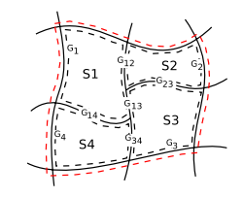


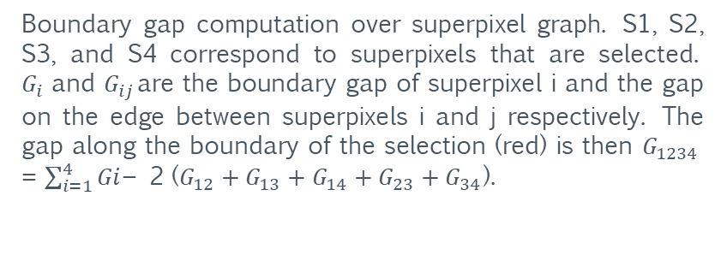
Closure Grouping for Boundary Detection
The algorithm transforms the problem of finding cycles of contour fragments to finding subsets of superpixels whose collective boundary has strong edge support in the image. The goal is to select a maximal set of superpixels which have high spatial coherence and whose boundary has strong contour support in the image.
Define the cost function, where numerator is the boundary gap along perimeter of superpixels and denominator is the sum of areas of superpixels.
$P_{i}$is the perimeter length of superpixel i and $P_{ij}$is the length of the shared edge between superpixels i and j. Similarly, $E_{i}$is the edginess of superpixel i boundary, and $E_{ij}$is the edginess for the shared boundary between superpixels. Let the superpixel i and superpixel j edge gaps be $G_{i}$= $P_{i}$- $E_{i}$and $G_{ij}$= $P_{ij}$- $E_{ij}$respectively. Let $A_{i}$be the area of superpixel i. X is a full labeling of the superpixels as 0 and 1.ddddddddddddddddddddddddddd
Boundary gap computation over superpixel graph. S1, S2, S3, and S4 correspond to superpixels that are selected. $G_{i}$and $G_{ij}$are the boundary gap of superpixel i and the gap on the edge between superpixels i and j respectively. The gap along the boundary of the selection (red) is then $G_{1234}$ = $\sum_{i=1}^{4}{Gi}$− 2 ($G_{12}+G_{13}+G_{14}+G_{23}+G_{34}$).

Slide 7
Object Searching Algorithm
For an image, model the objects' relationship as a graph and use DFS to search objects at different levels.

Slide 8
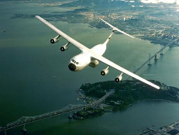
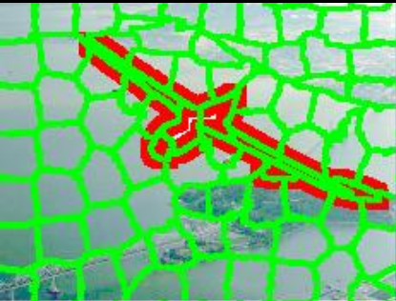
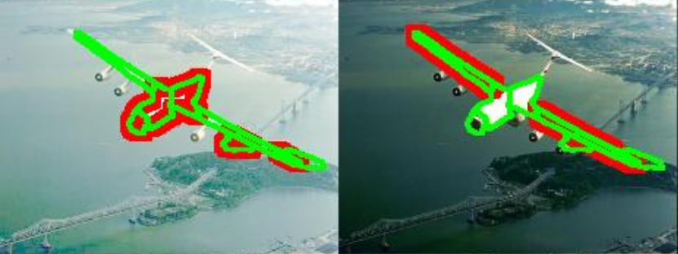
Basic Result

Slide 9
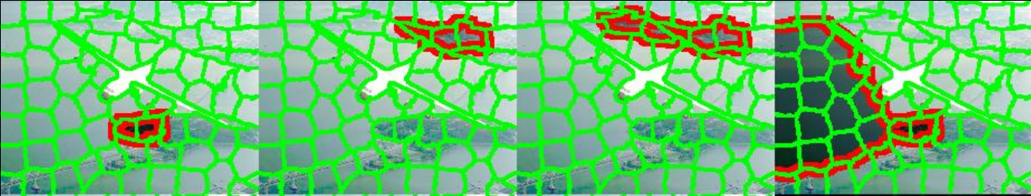
Basic Result

Slide 10
Thanks!

